Slide 1
Web technologies
HTML Part

Slide 2

topics
HTML Theory
HTML document structure
HTML element structure
Important tags
Tag attributes
Table tags
Semantic vs Non-semantic
List
Form
XML
XHTML
DHTML
DOM

Slide 3





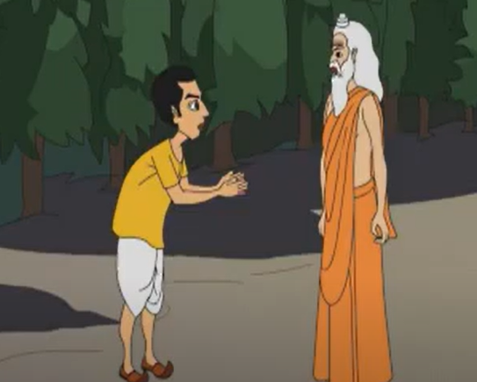

HTML
CSS
Javascript
Programmer
ChatGPT

Slide 4
HTML
HyperText Markup Language
Describes structure of a web page (what content will exist, order of content and how elements are nested within containers)
Tim Berners-Lee in 1993
HTML Documents = Web Pages
HTML = Collection of elements
Element = Tag + attribute + content
Case insensitive. So, <body>, <BODY>, <Body>, <boDy> all are same things in HTML

Slide 5
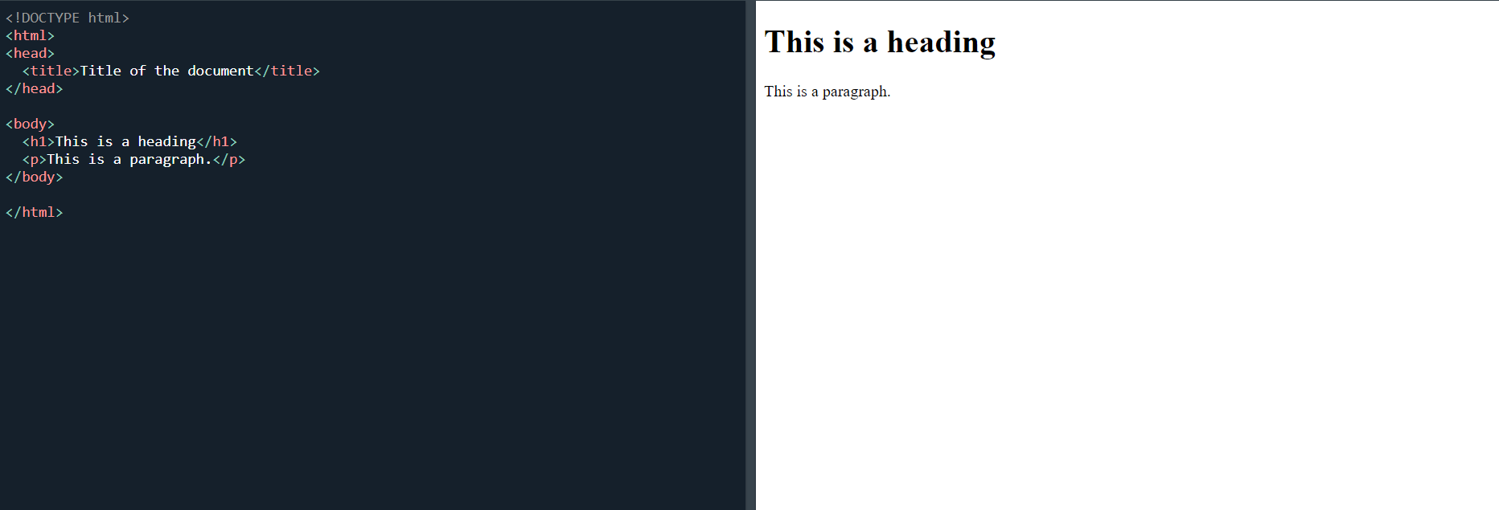
HTML document structure
HTML Code
Output

Slide 6
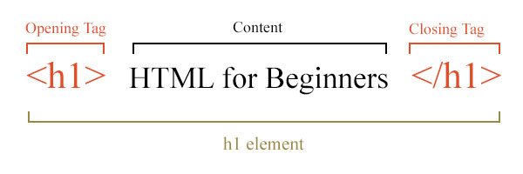
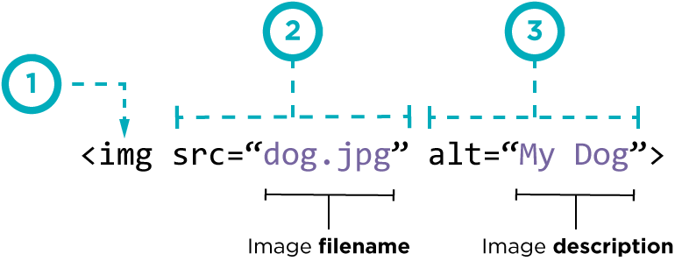
HTML Element structure
Element = Tag + attribute + Content
Self closing tags don’t have closing tag. Example: <br>, <hr>, <img>

Slide 7
Important Tags
<html>: The root element that contains the entire HTML document. All content is written inside this tag.
<head>: It contains metadata and links to external resources that are added to the HTML document.
<body>: It contains all the content that appears on the web page.
<doctype>: Declares the HTML version and helps browsers render the page correctly.
<h1> to <h6>: Headings. (Most important h1 to least h6)
<p>: Paragraph
<a>: Anchor tag. Hyperlink to another resource
<button>: Button
<ul>: Unordered list
Self-closing tags (no closing tags): <img>, <br>, <hr>, <link>, <input>

Slide 8

Important Tags
Favicon: It is added inside <head> tag using <link> tag.
Title: It is also added in the <head> tag.
Example: <head> <link rel="icon" type="image/x-icon" href="google.ico"> <title> Google </title> </head>
Favicon
Title

Slide 9
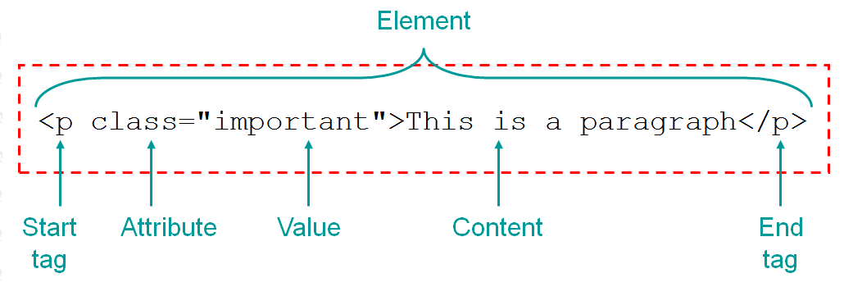
attributes
Attributes provide additional information about an element
Usually come in name/value pairs, like: id=“ navbar“
Always specified in the start tag
Some attributes are global (can be used on any tag), while others are specific to certain elements.
<a href="https://www.aiub.edu">AIUB</a>
<img src="img_girl.jpg">

Slide 10
Table tags
Tag | Description
<table></table> | To create a table
<tr></tr> | For each row
<th></th> | For column headers (bold)
<td></td> | For cell values
<thead></thead> | Semantic for table header
<tbody></tbody> | Semantic for table body
<tfoot></tfoot> | Semantic for table footer

Slide 11
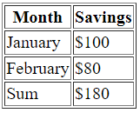
Table example
<table border=1>
<thead>
<tr>
<th>Month</th>
<th>Savings</th>
</tr>
</thead>
<tbody>
<tr>
<td>January</td>
<td>$100</td>
</tr>
<tr>
<td>February</td>
<td>$80</td>
</tr>
</tbody>
<tfoot>
<tr>
<td>Sum</td>
<td>$180</td>
</tr>
</tfoot>
</table>

Slide 12
Semantic vs non-semantic tags
Symantic tags | Non-symantic tags
Specifically used to give clear meaning | Do not emphasize meaning
<header>, <main>, <nav>, <footer>, <section> | <div>, <span>, <br>

Slide 13
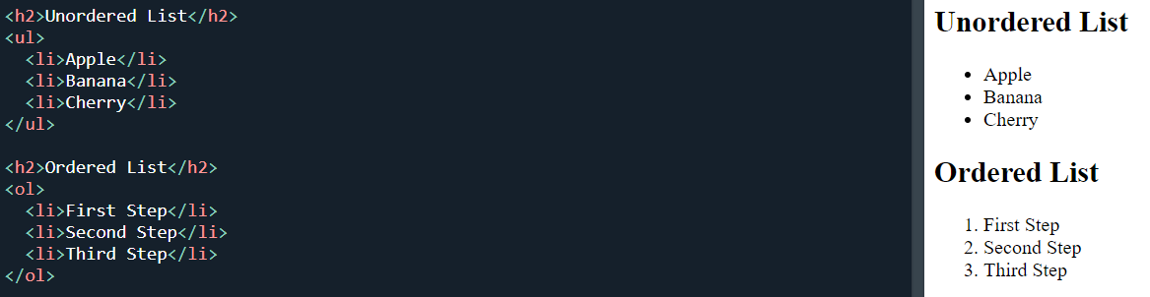
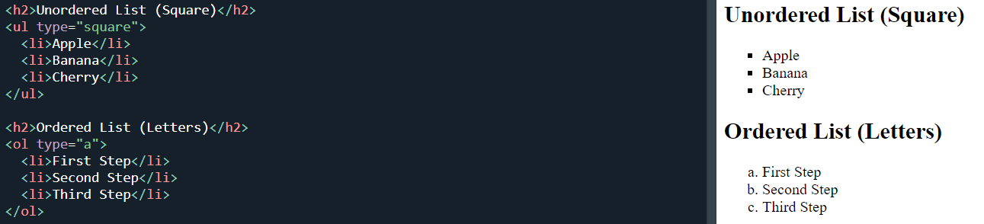
lists
<ul>: Unordered list. Displays items with bullet points (e.g., disc, circle, square)
<ol>: Ordered list. Displays items with a specific order (e.g., numbers, letters, Roman numerals)
<li>: Defines each items of a list
Code snippet-1
Code snippet-2

Slide 14
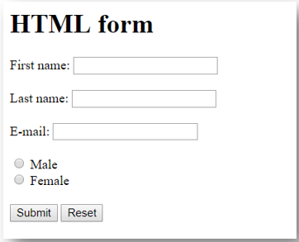
forms
An HTML Form is used to submit data
<form action="/submit_form“ method=“POST“>
<label for="first-name">First name:</label><br>
<input type="text" id="first-name" name="first-name"><br><br>
<label for="last-name">Last name:</label><br>
<input type="text" id="last-name" name="last-name"><br><br>
<label for="email">E-mail:</label><br>
<input type="email" id="email" name="email"><br><br>
<label for="gender">Gender:</label><br>
<input type="radio" id="male" name="gender" value="male">
<label for="male">Male</label><br>
<input type="radio" id="female" name="gender" value="female">
<label for="female">Female</label><br><br>
<input type="submit" value="Submit">
<input type="reset" value="Reset">
</form>

Slide 15
Form tags & types
Here are the different tags you can use in a form:
<input>
<label>
<select>
<option>
<textarea>
<button>
<fieldset>
<legend>
Here are the different input types you can use in a form:
<input type=“submit">
<input type="checkbox">
<input type="email">
<input type="file">
<input type="hidden">
<input type="image">
<input type="month">
<input type="number">
<input type="password">
<input type="radio">
<input type="range">

Slide 16
Form attributes
action: Specifies a URL where form data will be sent after submission. Example: <form action="/submit_form">
enctype: Encodes data while submitting.
application/x-www-form-urlencoded: Default encoding type for text data.
multipart/form-data: Required for forms that upload files.
text/plain: Sends data as plain text.
Example: <form enctype="multipart/form-data">
target: Specifies where to display the response after submitting the form. Common values include:
_self (default): Displays the response in the same window or tab.
_blank: Opens the response in a new tab or window.
_parent: Displays the response in the parent frame.
_top: Displays the response in the full body of the window.
Example: <form target="_blank">

Slide 17
Form attributes
autocomplete: Specifies whether the browser should automatically complete the form fields.
on: Allows autocomplete.
off: Disables autocomplete.
Example: <form autocomplete="off">
novalidate: Prevents the browser from performing the default form validation.
Example: <form novalidate>
method: Defines the HTTP method (GET or POST).
GET: Appends the form data to the URL
POST: Sends the form data in the body of the request (more secure).
Example: <form method="POST">

Slide 18
Inline vs block
Inline elements | Block elements
Does not start on a new line | Starts on a new line
Only take up as much width as their content | Take the full available width by default
<span>, <a>, <img>, <label>, <input> | <p>, <div>, <h1>, <form>

Slide 19
Get vs post
Feature | GET | POST
Browsing History | Saved | Not saved
Length | 2048 characters maximum | No restriction
Data types | ASCII types only | No restriction
Security | Less secure. Because data is sent as URL | Much safer
Visibility | Data visible to everyone as URL | Data is not displayed as URL
Bookmark | Can be bookmarked | Can not be bookmarked
Cache | Can be cached | Can not be cached
Back/reload button | Harmless | Data resubmitted
Enctype | application/x-www-form-urlencoded | application/x-www-form-urlencoded or multipart/form-data

Slide 20
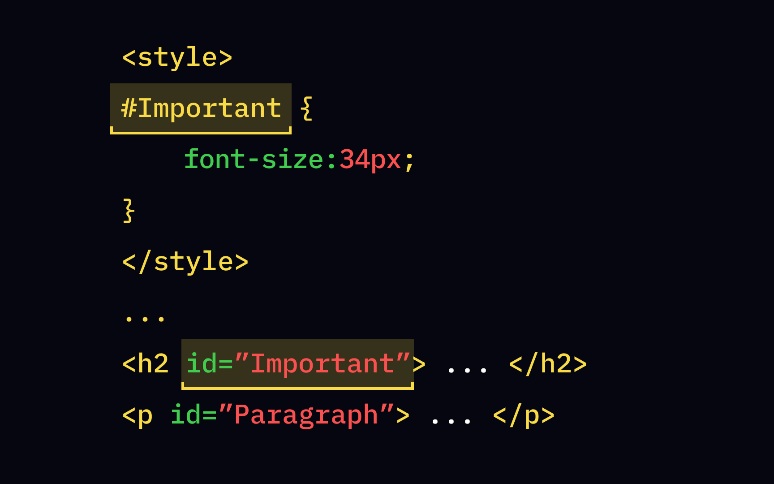
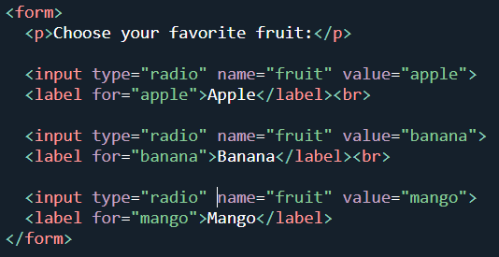
ID vs name
Id attribute | Name attribute
Uniquely identify a single element | Primarily used to reference form elements
Must be unique within the document | Usually shared by multiple elements to group them
Used as a selector for CSS and JS for DOM manipulation | Used for form data handling

Slide 21
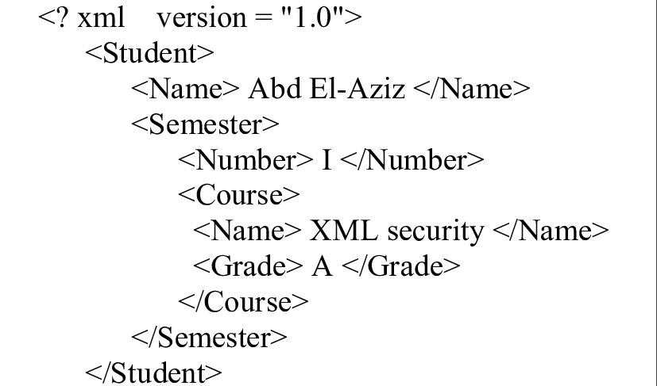
XML
XML stands for eXtensible Markup Language.
XML was designed to store and transport data, not to display data
XML tags are not predefined
XML is a W3C Recommendation
XML tags are self-descriptive. They are both human and machine-readable.
XML have tree-like structured

Slide 22
XHTML, DHTML
XHTML (eXtensible Hyper Text Markup Language)
It is a combination of XML and HTML. Stricter than HTML (well-formed syntax)
DHTML (Dynamic HTML)
It is a collection of technology (HTML, JavaScript, CSS, DOM) that enables HTML to be dynamic and interactive.
Static webpage: Not interactive. Users can only view contents.
Dynamic webpage: Interactive and dynamic. Content can change based on user actions or data

Slide 23
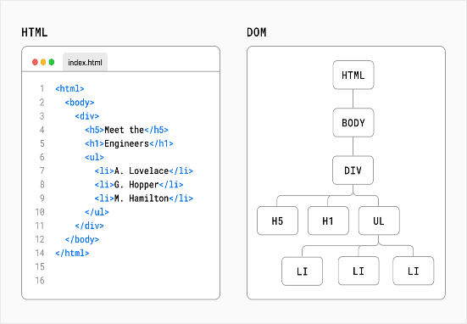
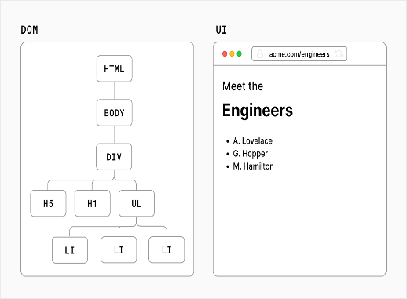
DOM (Document object model)
A standard for accessing documents like XML and HTML
Allows programs to dynamically access and update a document.
The nodes of every document are organized in a tree structure, called the DOM tree.

Slide 24
More Important tags
Text content: <p>, <span>, <h1> to <h6>, <a>, <br>, <hr>
Text formatting: <i>, <strong>, <b>, <em>, <u>, <sub>, <sup>
Container: <div>, <section>, <main>, <nav>, <header>, <footer>, <aside>
Lists: <ul>, <ol>, <li>
Table: <table>, <thead>, <tbody>, <tfoot>, <th>, <td>, <tr>
Media: <img>, <iframe>
Forms and input: <form>, <input>, <select>, <option>, <label>, <button>, <textarea>
Document structure and meta: <html>, <head>, <body>, <link>, <script>, <meta>, <title>, <style>

